Slide 1
LOAN MANAGEMENT
SYSTEM (FMFB)

Slide 2


AGENDA
1. INTRODUCTION
2. Work Done
3. Work in Progress
4. Next Steps

Slide 3

PROJECT OVERVIEW
LARAVEL APPLICATION FOR:
UI
USER ROLES
LOAN WORKFLOWS
PRINTABLE DOCUMENTATION
BUSINESS LOGIC
REPAYMENT CALCULATIONS

Slide 4
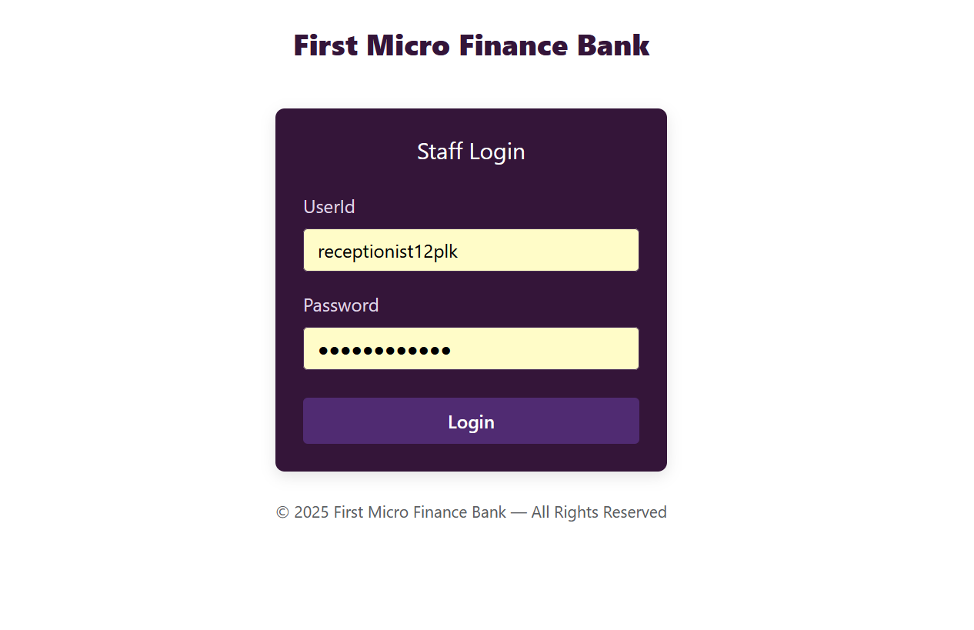
SIGN‑IN PAGE

Slide 5
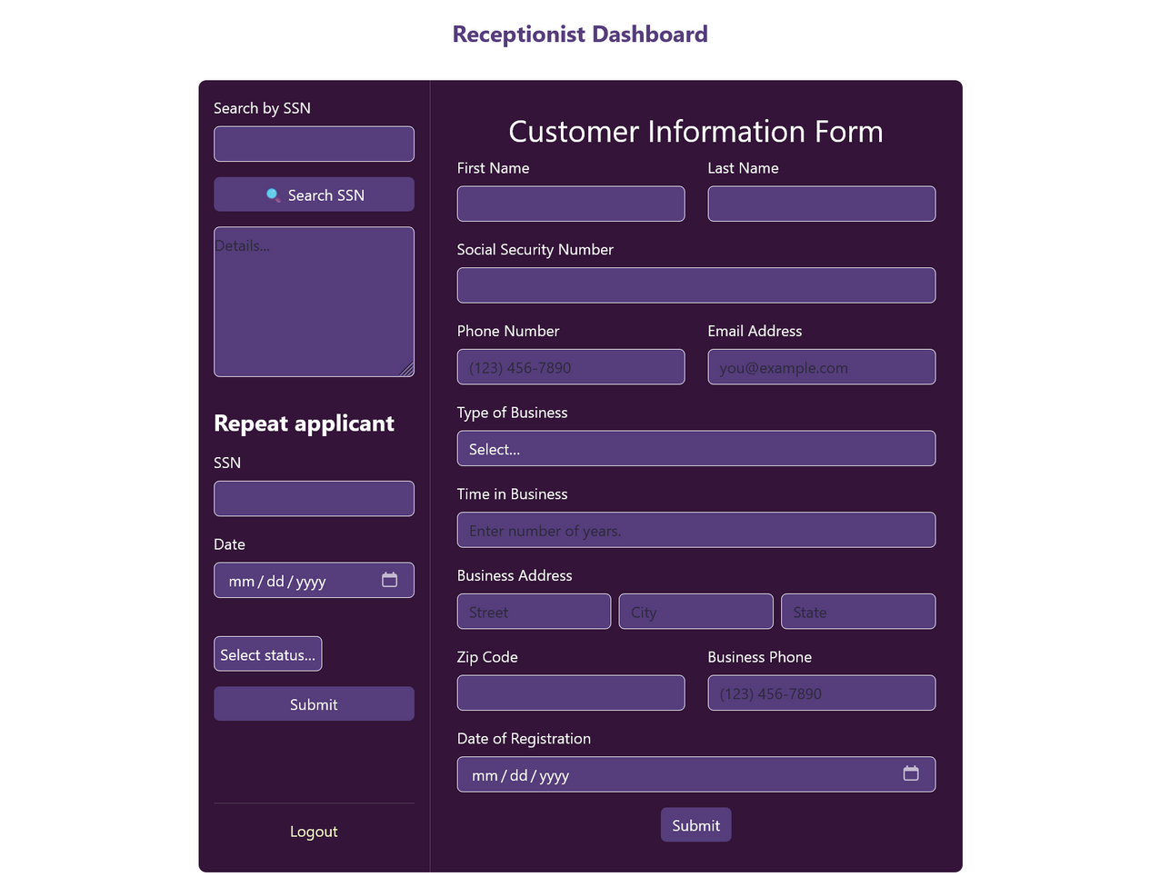
Loan Officer Dashboard

Slide 6
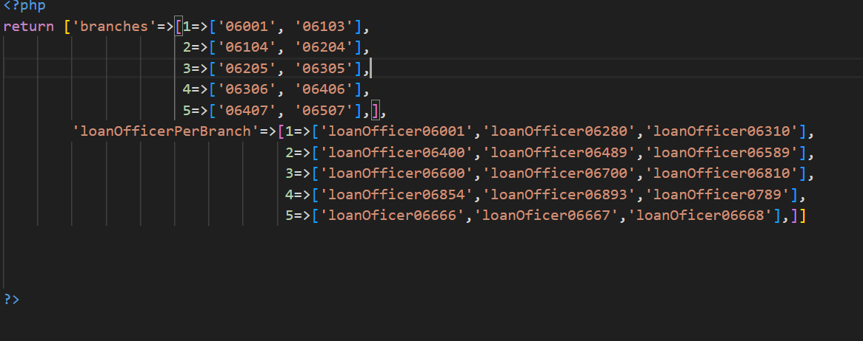
FILTER CUSTOMER BY ZIPCODE

Slide 7
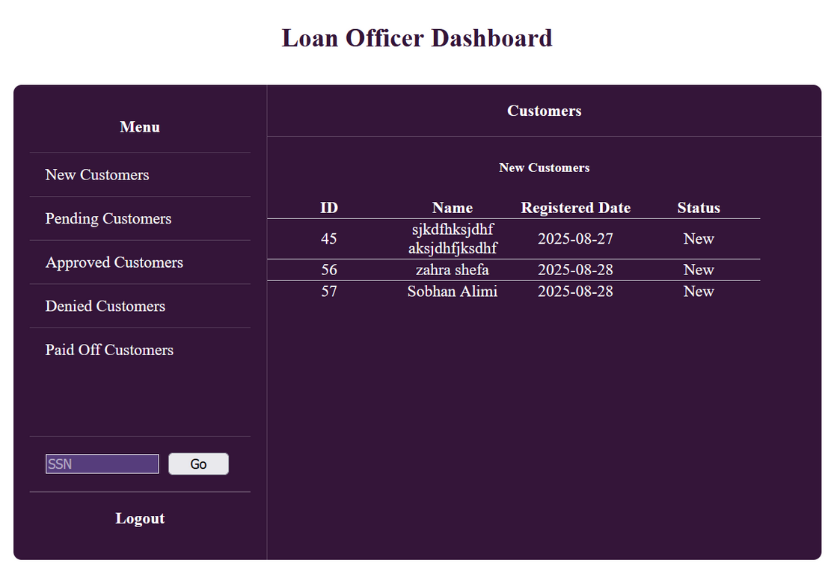
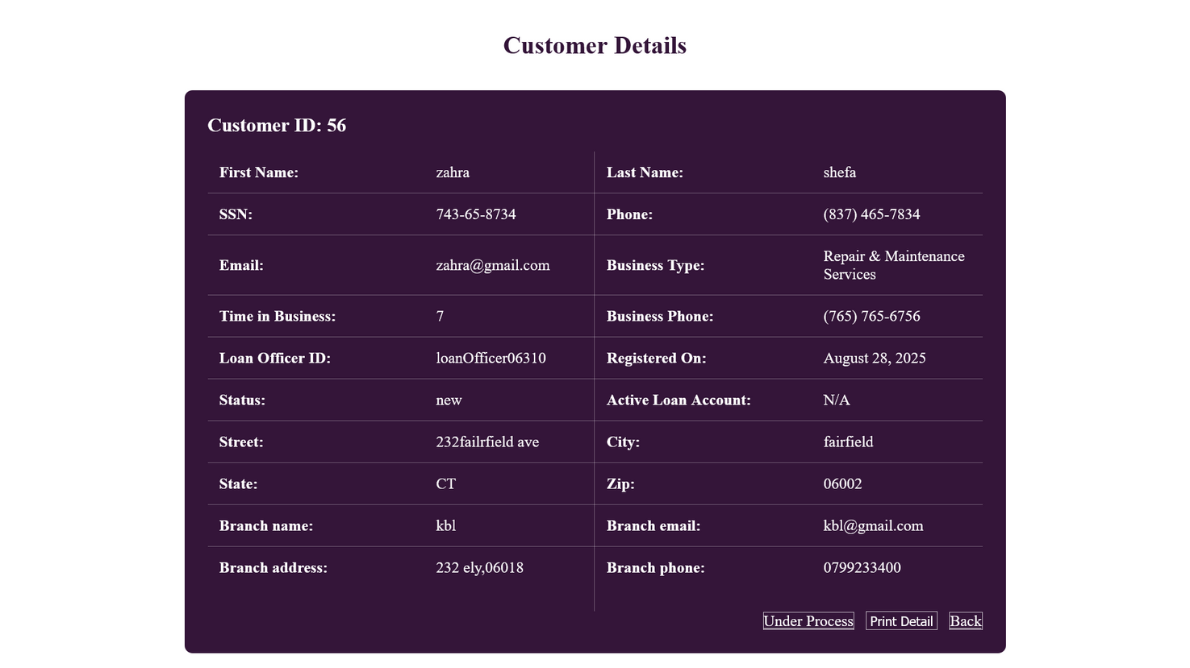
LOAN OFFICER DASHBOARD

Slide 8
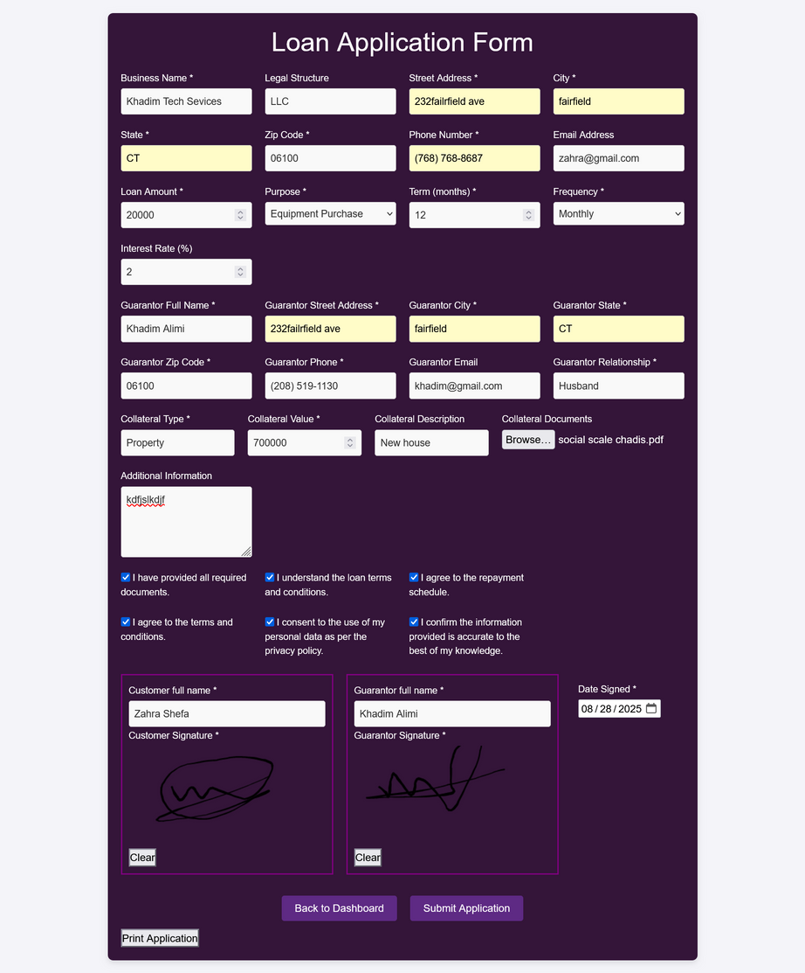
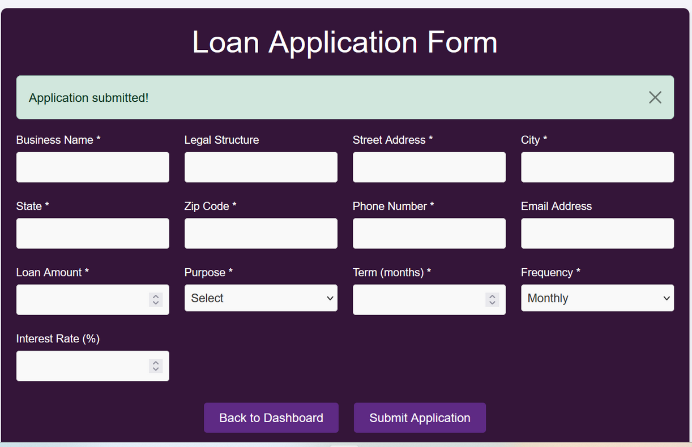
LOAN OFFICER DASHBOARD

Slide 9
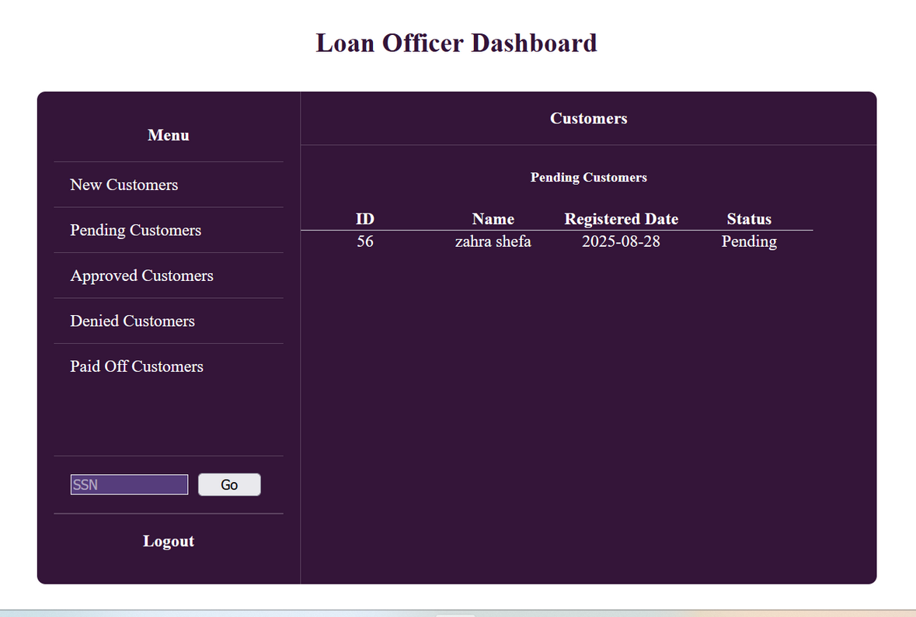
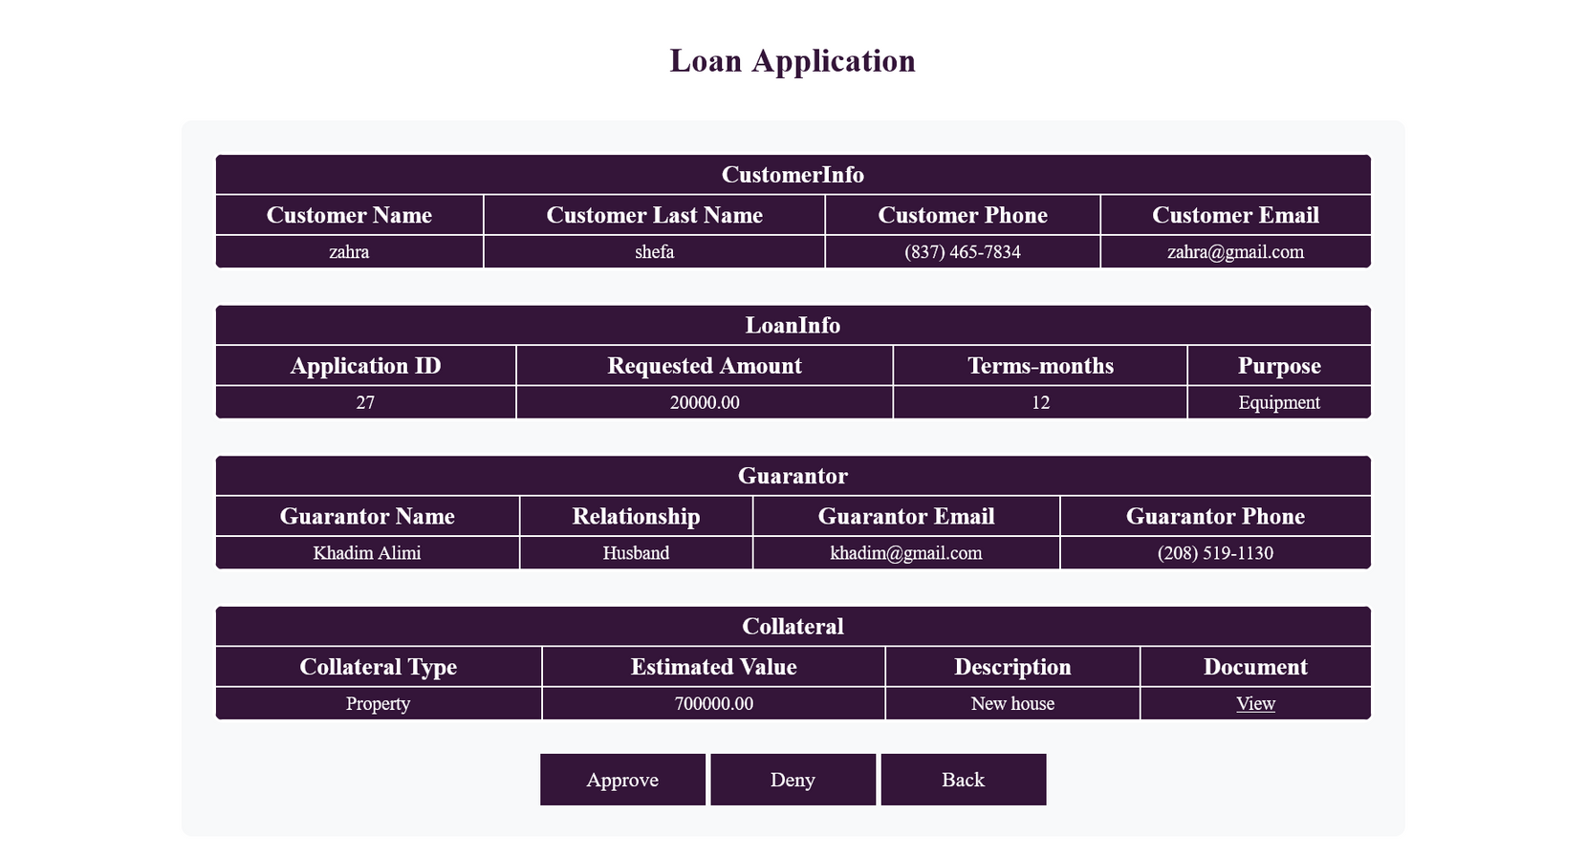
LOAN OFFICER DASHBOARD

Slide 10
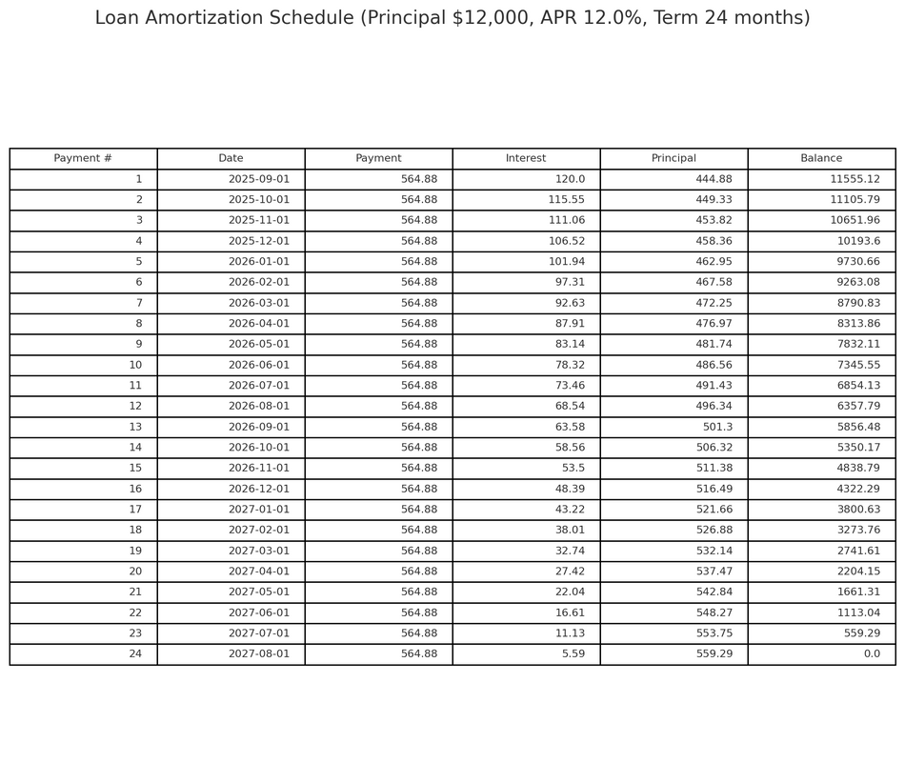
WORK IN PROGRESS
Working on payment schedule

Slide 11
Consultation
NEXT STEP
Quality Assurance & Delivery
Design & Prototyping
SETTING UP LOGOUT FUNCTIONALITY IN DASHBOARDS
CREATING UNIT TESTS
Implementation

